Slide 1


Karthikeyan Ilango
17-06-2022

Slide 2

Outline
Executive Summary
Introduction
Methodology
Results
Conclusion
Appendix

Slide 3
Executive Summary
Summary of methodologies
Data collection using API and Web Scraping
Data Wrangling
Exploratory Data Analysis with SQL
Data Visualization
Interactive visual analytics with folium
Machine learning
Summary of all results
Exploratory Data analysis results
Interactive analytics
Predictive analytics result

Slide 4
Introduction
Project background and context
One reason SpaceX can do this is the rocket launches are relatively inexpensive. SpaceX advertises Falcon 9 rocket launches on its website with a cost of 62 million dollars; other providers cost upwards of 165 million dollars each, much of the savings is because SpaceX can reuse the first stage. Therefore, if we can determine if the first stage will land, we can determine the cost of a launch. The goal is to predict whether the first stage will land successfully using machine leanring
Problems you want to find answers
Determining the factors that influence a successful landing
Interaction between various factors and their impact on the success rate

Slide 5

Section 1

Slide 6
Methodology
Executive Summary
Data collection methodology:
The Data required were acquired using SpaceX API and information available in the Wikipedia is
Perform data wrangling
One hot encoding was applied to the categorical attributes
Perform exploratory data analysis (EDA) using visualization and SQL
Perform interactive visual analytics using Folium and Plotly Dash
Perform predictive analysis using classification models
Various machine learning prediction using models such as KNN, SVC, Decision Tree and Logistic Regression is carried out

Slide 7
Data Collection
Describe how data sets were collected.
Data collection is done using the help of SpaceX API.
A get request I send and the obtained .json file is converted into pandas data frame using the function .json_normalize()
The data is then cleaned, and the missing values are replaced with mean and processed.
Furthermore, data available in the space X Wikipedia page is web scraped using beautifulSoup
HTML tables are then converted into pandas data frame for further analysis.

Slide 8
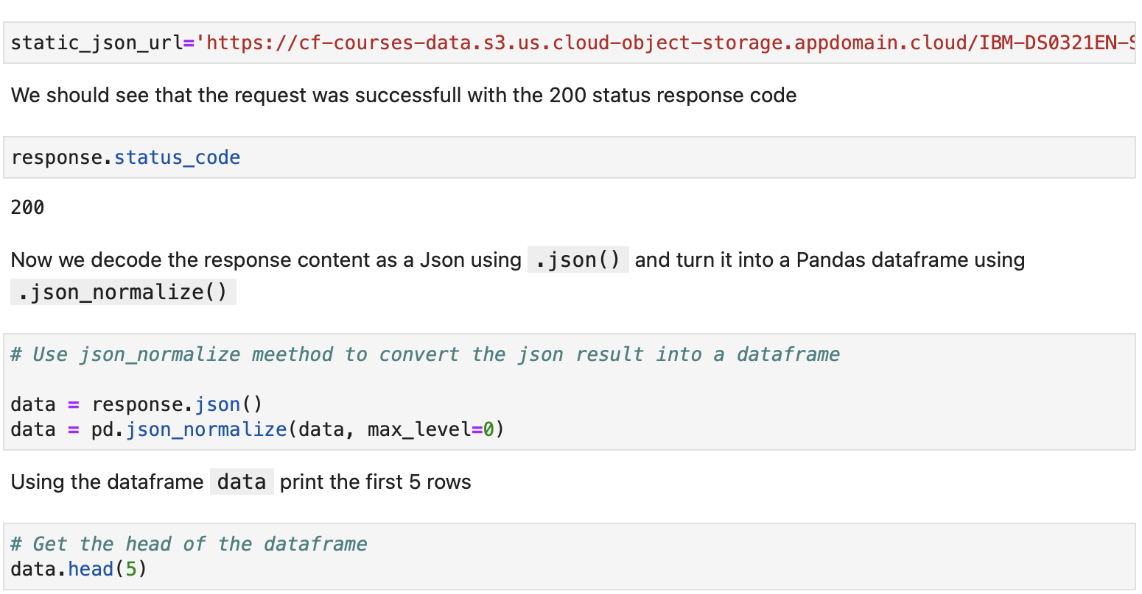
Data Collection – SpaceX API
SpaceX API is used to collect data. The data is requested and then some basic data wrangling and formatting is done
GitHub URL :https://github.com/karthik2411/IBM-Data-Science/blob/main/Data%20collection%20API.ipynb
Place your flowchart of SpaceX API calls here

Slide 9
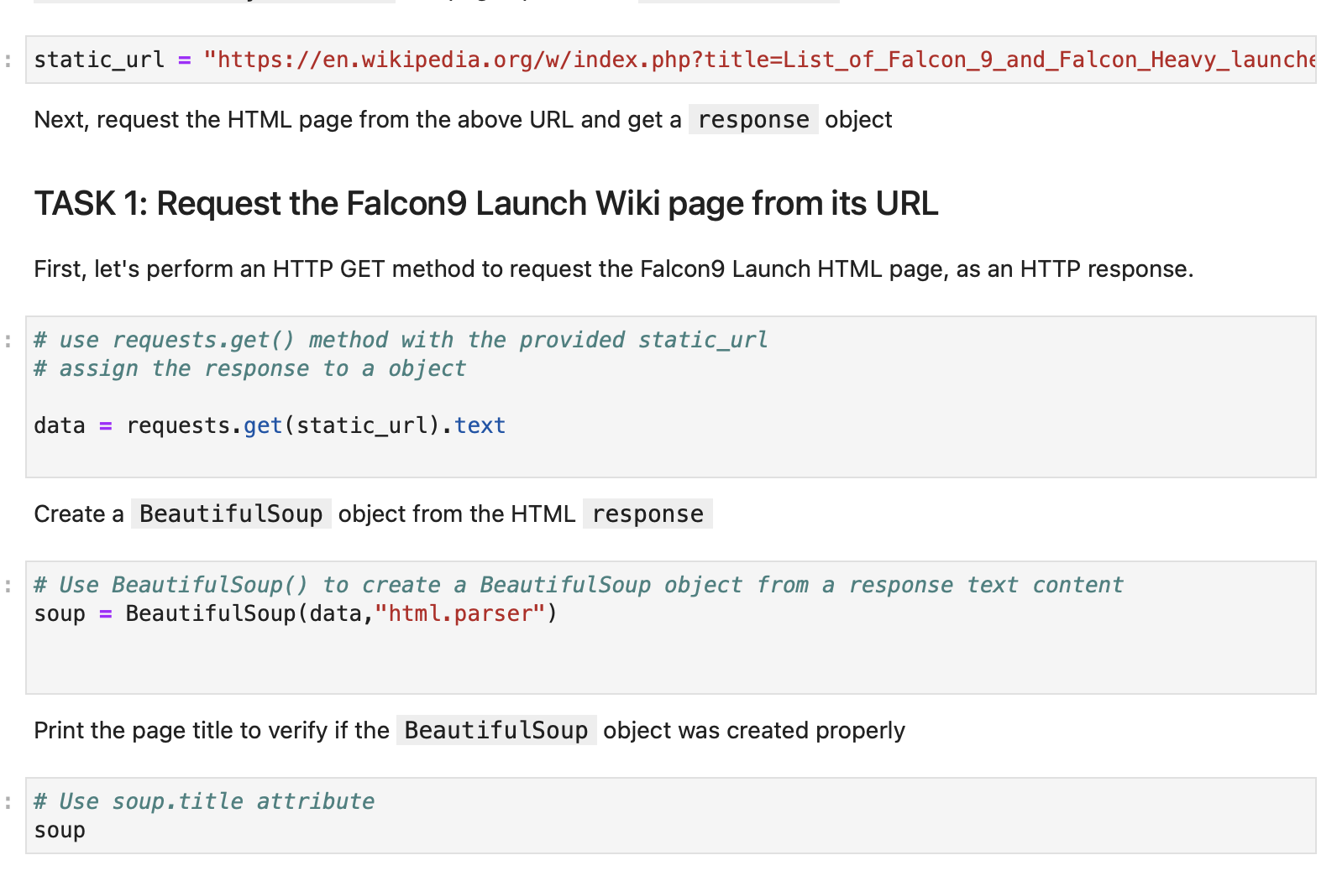
Data Collection - Scraping
Web scrapping the SpaceX Wikipedia is done with beautifulsoup
GitHub URL : https://github.com/karthik2411/IBM-Data-Science/blob/main/Data%20Collection%20-%20webscraping.ipynb
Place your flowchart of web scraping here

Slide 10
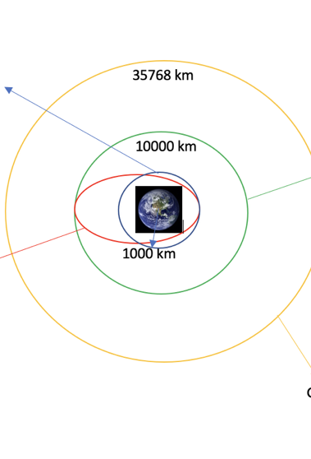
Data Wrangling
We calculated the number of launches at each site, and the number and occurrence of each orbits
GitHub URL : https://github.com/karthik2411/IBM-Data-Science/blob/main/Data%20wrangling.ipynb

Slide 11
EDA with Data Visualization
We explored the data with the help of visualization in order to obtain the following insights
The relationship between Flight Number and Launch Site
The relationship between Payload and Launch Site
The relationship between success rate of each orbit type
The relationship between FlightNumber and Orbit type
Visualize the launch success yearly trend
GitHub URL : https://github.com/karthik2411/IBM-Data-Science/blob/main/Exploratory%20analysis%20with%20Data%20Visualization.ipynb

Slide 12
EDA with SQL
The SQL queries used to perform the following find the following insights
The names of the unique launch sites in the space mission
5 records where launch sites begin with the string 'CCA'
the total payload mass carried by boosters launched by NASA (CRS)
total number of successful and failure mission outcomes
the booster_versions which have carried the maximum payload mass.
GitHub URL : https://github.com/karthik2411/IBM-Data-Science/blob/main/Exploratory%20analysis%20with%20SQL.ipynb

Slide 13
Build an Interactive Map with Folium
All launch sites were added to the map as object .
Launch outcome (I.e., success or failure) is marked as 0 and 1 where 0 is for failure and 1 is for successful
Clusters are identified for launch sites that have relatively high success rates
GitHub URL : https://github.com/karthik2411/IBM-Data-Science/blob/main/Interactive%20Visual%20Analytics%20using%20Folium.ipynb

Slide 14
Build a Dashboard with Plotly Dash
An interactive dashboard is built with Plotly dash
Pie charts are plotted to show the total launches by a certain sites
The scatter graph is showing the relationship with Outcome and Payload Mass (Kg) for the different booster version.
GitHub URL : https://github.com/karthik2411/IBM-Data-Science/blob/main/Dashboard%20with%20plotly%20dash.ipynb

Slide 15

Predictive Analysis (Classification)
Using Numpy and Pandas the data is loaded and transformed, which is then divided into training and testing data
Different machine learning models are employed using gridsearchcv
Accuracy of each model is calculated to determine best performing model
GitHub URL - https://github.com/karthik2411/IBM-Data-Science/blob/main/Machine%20Learning%20Prediction.ipynb

Slide 16
Results
Exploratory data analysis results
Interactive analytics demo in screenshots
Predictive analysis results

Slide 17

Section 2

Slide 18
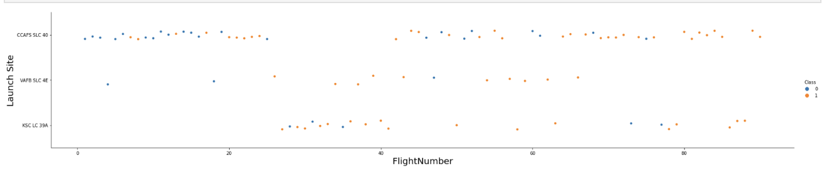
Flight Number vs. Launch Site

Slide 19
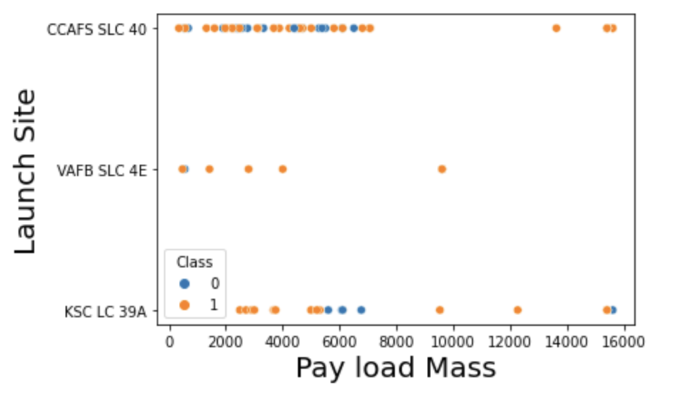
Payload vs. Launch Site

Slide 20
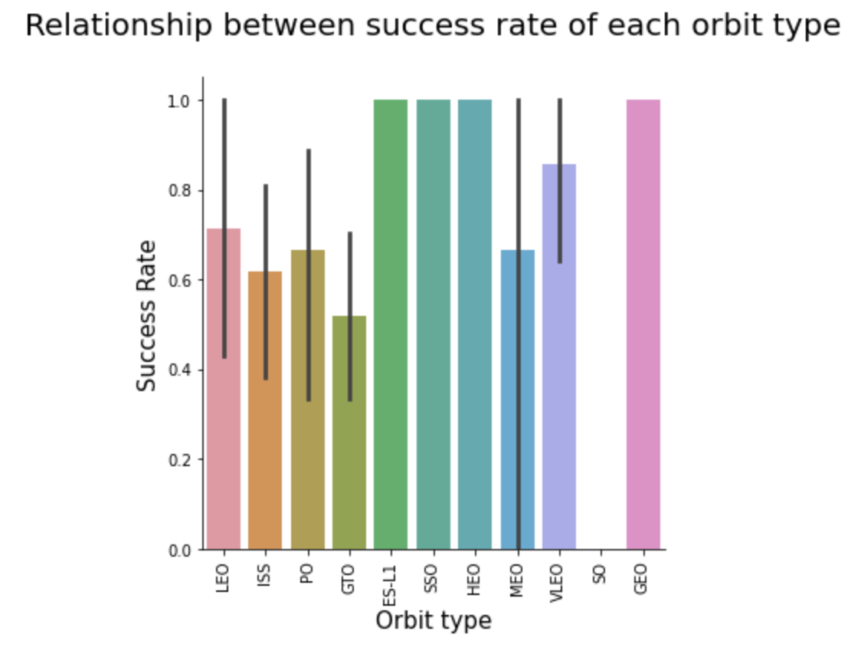
Success Rate vs. Orbit Type

Slide 21
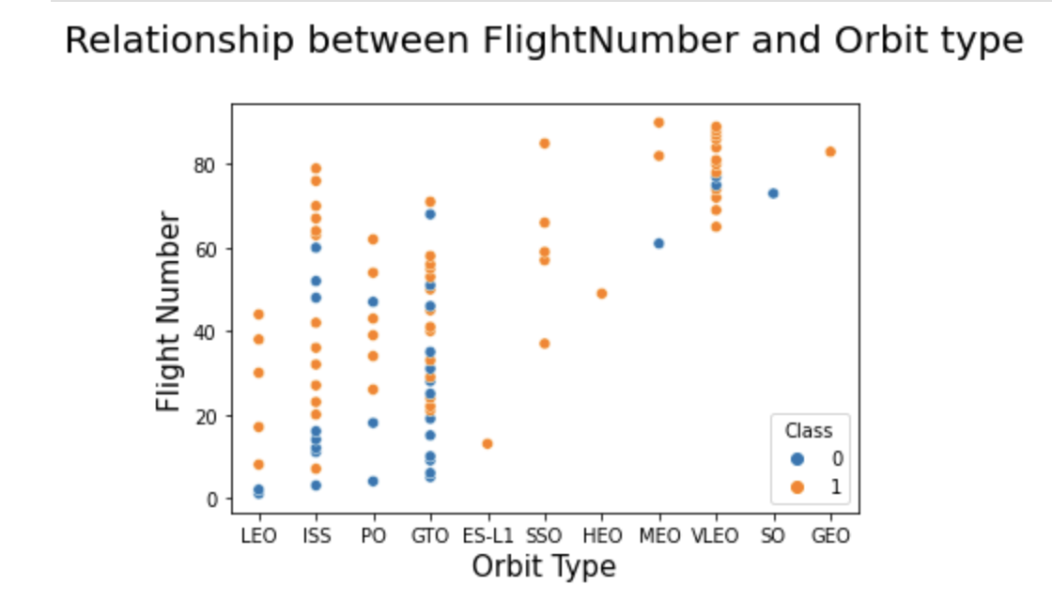
Flight Number vs. Orbit Type

Slide 22
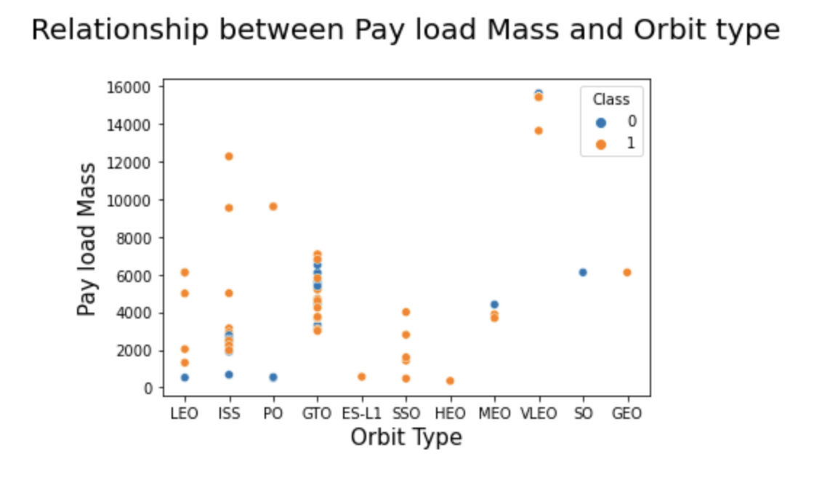
Payload vs. Orbit Type

Slide 23
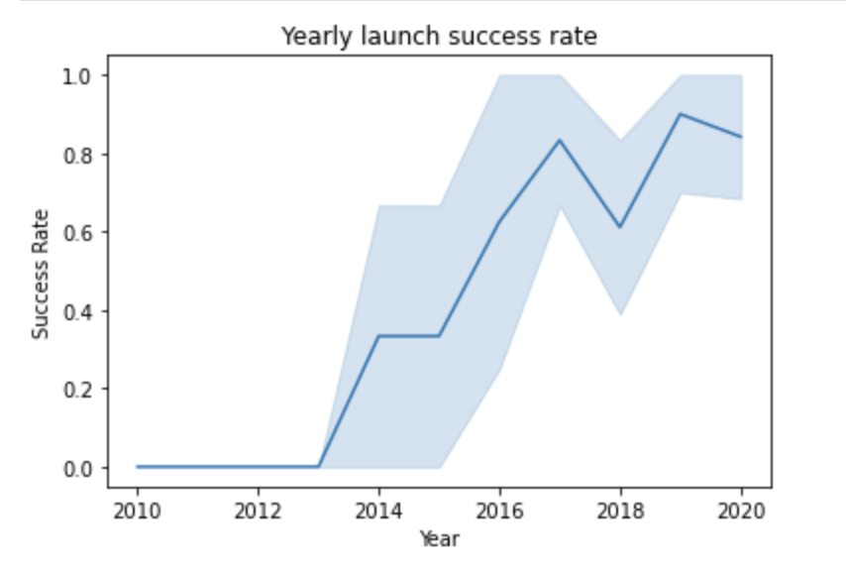
Launch Success Yearly Trend

Slide 24

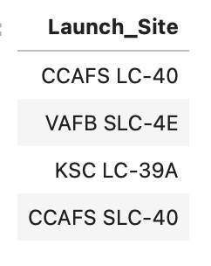
All Launch Site Names

Slide 25

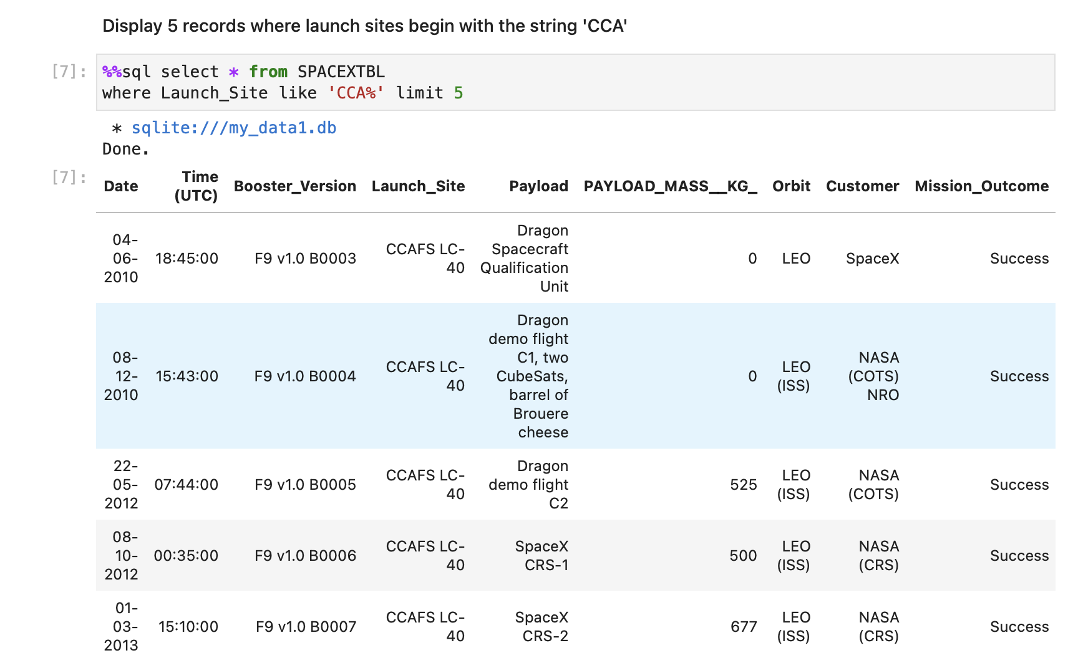
Launch Site Names Begin with 'CCA'

Slide 26

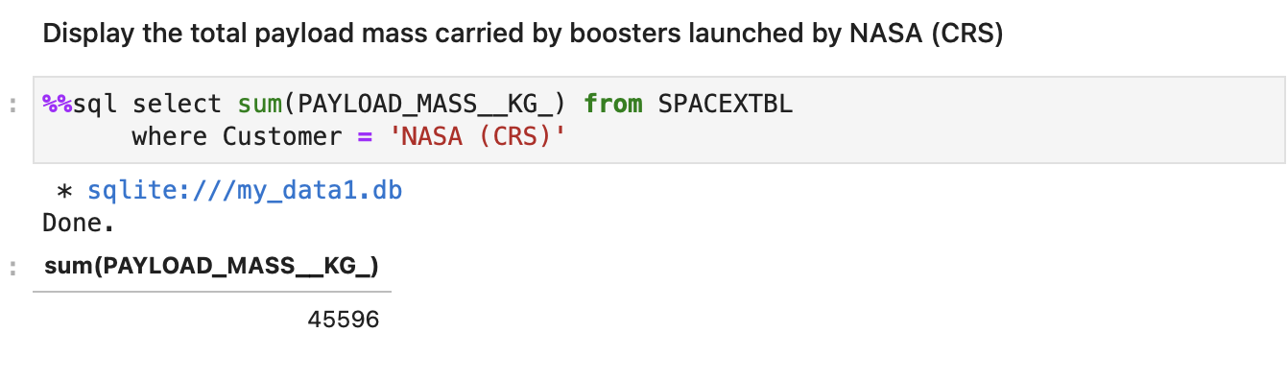
Total Payload Mass

Slide 27
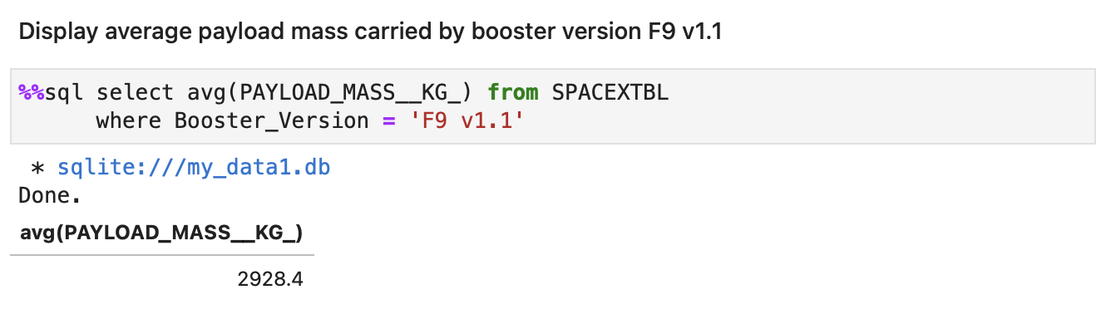
Average Payload Mass by F9 v1.1

Slide 28
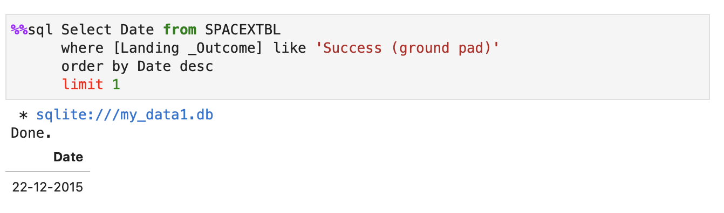
First Successful Ground Landing Date

Slide 29
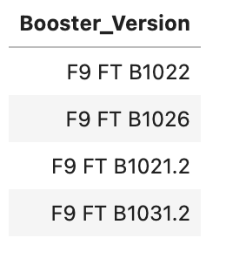
Successful Drone Ship Landing with Payload between 4000 and 6000
List the names of boosters which have successfully landed on drone ship and had payload mass greater than 4000 but less than 6000

Slide 30
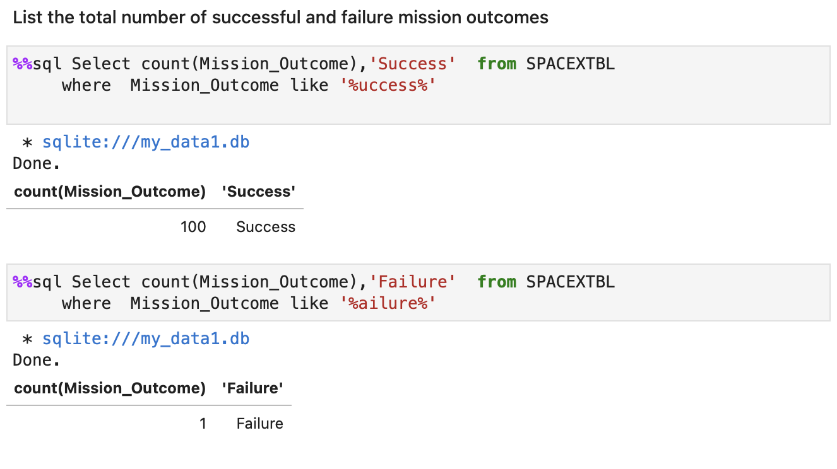
Total Number of Successful and Failure Mission Outcomes

Slide 31
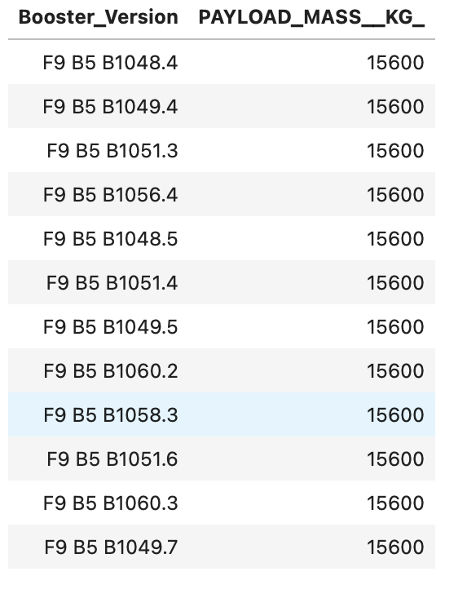
Boosters Carried Maximum Payload
List the names of the booster_versions which have carried the maximum payload mass. Use a subquery

Slide 32
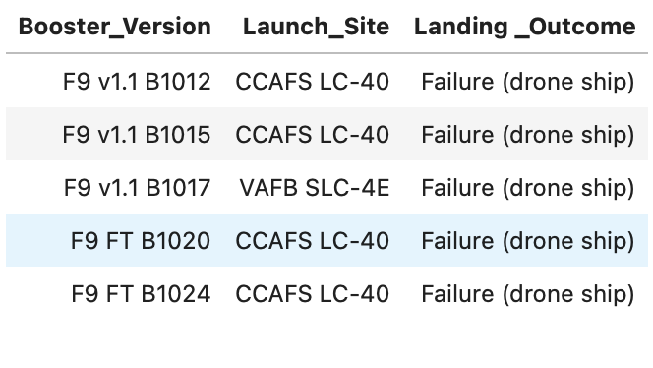
2015 Launch Records
List the records which will display the month names, failure landing_outcomes in drone ship ,booster versions, launch_site for the months in year 2015.

Slide 33
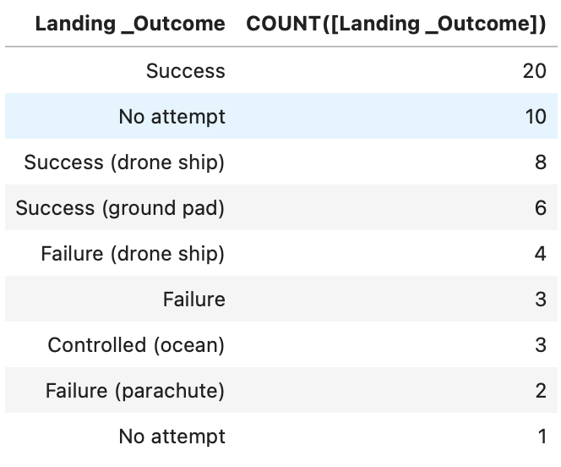
Rank Landing Outcomes Between 2010-06-04 and 2017-03-20

Slide 34

Section 3

Slide 35


Slide 36


Slide 37


Slide 38

Section 4

Slide 39


Slide 40


Slide 41


Slide 42

Section 5

Slide 43
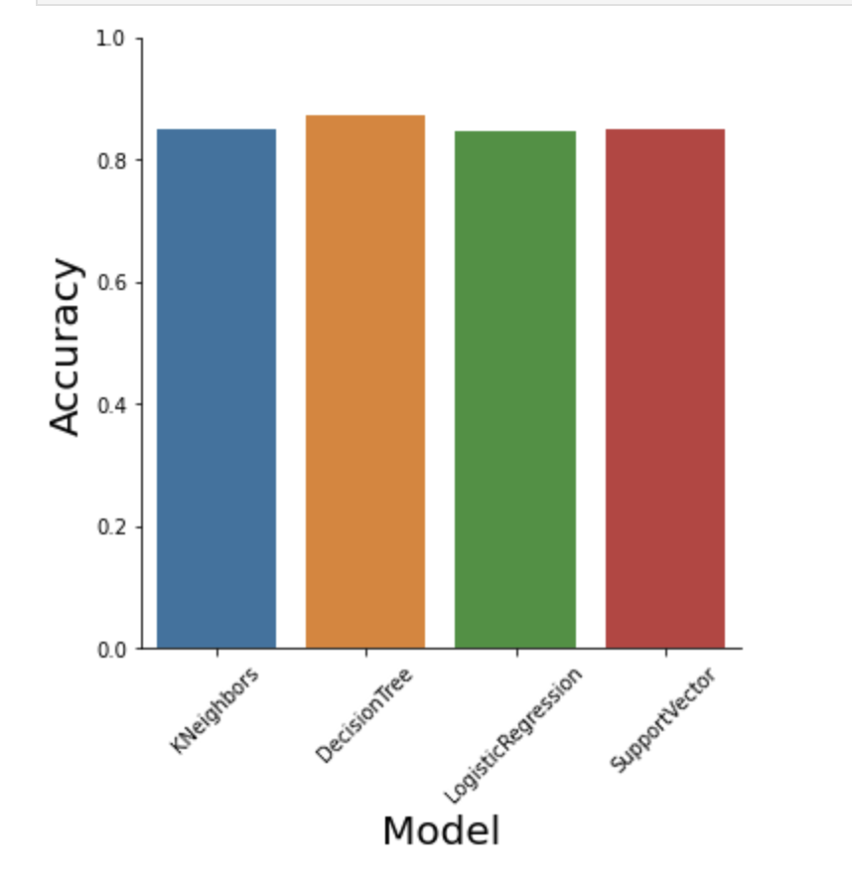
Classification Accuracy
The Decision tree model is more accurate when compared to other models. The accuracy of the decision tree is 87.32%

Slide 44
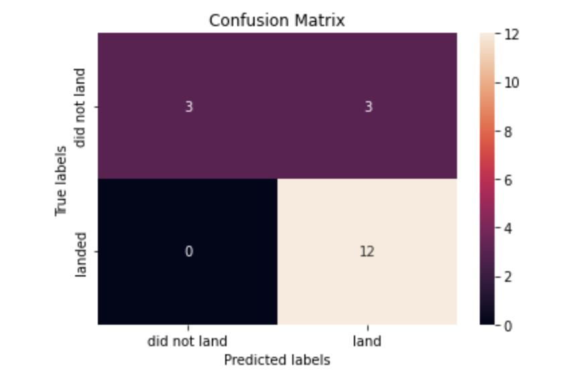
Confusion Matrix
The confusion matrix for the decision tree is shown below.

Slide 45
Conclusions
The success rate of a launch site increases with the number of flights launched at that site.
The success rate drastically increased after 2013.
Orbits ES-L1, GEO, HEO, SSO, and VLEO had the most success rates
The most successful launch site is KSC LC-39A
Based on the Machine learning prediction, the Decision Tree is more accurate than other methods.

Slide 46


